Slide 1
Introduction to Programming (II)
11020 - Binary search trees using polymorphism

Slide 2
Outline
Definition of Binary Search Trees
Implementation of the BST Data Structure
Detailed C++ Implementation for BST

Slide 3
Outline
Definition of Binary Search Trees
Implementation of the BST Data Structure
Detailed C++ Implementation for BST

Slide 4
Binary Search Trees
A binary search tree (BST) is a binary tree, each of whose internal nodes
stores a key and
has two sub-trees,
commonly denoted left and right.
BST property: The tree additionally satisfies the property
the key in each node must be
greater than all keys stored in the left sub-tree, and
smaller than all keys in the right sub-tree.

Slide 5
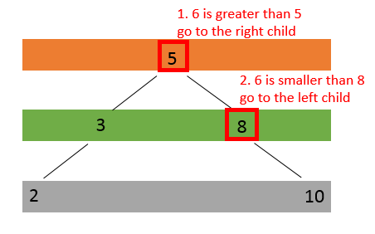
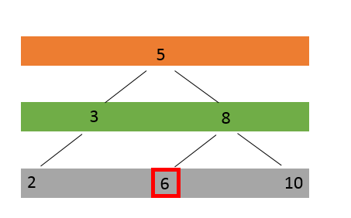
A BST Example
To Insert a node with key 6

Slide 6
Outline
Definition of Binary Search Trees
Implementation of the BST Data Structure
Detailed C++ Implementation for BST

Slide 7
Approach 1 to the implementation of the BST data structure: Array
An approach to storing a BST is to
use a single, contiguous block of memory cells, i.e., an array, for the entire tree.
The arrangement
We store the tree’s root node in the first cell of the array.
Then we store the left child of the root in the second cell, store the right child of the root in the third cell.
In general, continue to store the left and right children of the node found in cell n in the cells 2n and 2n+1, respectively.

Slide 8
An array-based BST
i
5
2i
2i+1
4i
4i+2
4i+3
3
8
4i+1
2
6
10
index
0
1
2 | 3
4 | 5 | 6 | 7
key
5
3 | 8
2 |  | 6 | 10

Slide 9
Approach 2 to the implementation of the BST data structure: Linked list
We set a special memory location, call a root pointer,
where we store the address of the root node.
Then each node in the tree must be set to
point to the left or right child of the pertinent node
or assigned the NULL value
if there are no more nodes in that direction of the tree.

Slide 10
A linked-list-based BST
5
3
8
2
6
10
Root pointer
5
8
3 |  | NULL
6 | NULL | NULL
10 | NULL | NULL
2 | NULL | NULL

Slide 11
Outline
Definition of Binary Search Trees
Implementation of the BST Data Structure
Detailed C++ Implementation for BST

Slide 12
Abstract base class
class BST{
public:
BST():Height(0){}
virtual ~BST() {}
virtual void insert(const int &) = 0;
virtual bool search(const int &) const = 0;
virtual void print() const = 0;
int height() const { return Height; } // An empty tree has height of 0. A tree with only root node has height of 1.
protected:
int Height;
};
Abstract base class BST declares the “interface”
that is, the set of member functions that a program can invoke on all BST objects

Slide 13
Concrete derived class Array_BST
class Array_BST : public BST{
public:
Array_BST();
virtual ~Array_BST() {}
virtual void insert(const int &) override; //root node is stored at index 1.
virtual bool search(const int &) const override;
virtual void print() const override;
private:
int array[1025];
};

Slide 14
Concrete derived class List_BST
class List_BST : public BST{
public:
List_BST();
virtual ~List_BST(){
deleteTree(root);
}
virtual void insert(const int &) override;
virtual bool search(const int &) const override;
virtual void print() const override;
private:
ListNode *root;
// private member functions
ListNode* createLeaf(int key) const; //new a ListNode and return its address
void deleteTree(ListNode *root);
void printGivenLevel(ListNode* Ptr, int level) const;
};
class ListNode{
friend class List_BST;
public:
ListNode(const int &info)
:key( info ),left( NULL ),
right( NULL ) //constructor
{
}//end ListNode constructor
private:
int key;
ListNode *left;
ListNode *right;
};

Slide 15
Search Example (1/2)
5 != 6
5 is less than 6, go to the left-subtree
Search 5
5 != 4
5 is greater than 4, go to the right-subtree
6
4
5 == 5
Return true
8
1
5
7
10

Slide 16
Search Example (2/2)
7 != 6
7 is greater than 6, go to the right-subtree
Search 7
6
4
7 != 8
1 is less than 8, go to the left-subtree
8
1
5
10
NULL
Return false
Notes:
**

Slide 17
Array_BST::search
bool Array_BST::search(const int &key) const {
int index = 1;
while (array[index]!= 0) {
if (array[index] == key)
return true;
else if (key > array[index])
index = index * 2 + 1;
else if (key < array[index])
index = index * 2;
}
return false;
}

Slide 18
List_BST::search
bool List_BST::search(const int &key) const {
ListNode* temp = root;
while(temp != NULL){
if(temp->key == key)
return true;
else if(key > temp->key)
temp = temp->right;
else if(key < temp->key)
temp = temp->left;
}
return false;
}

Slide 19
Insertion Example
6 is greater than 4 go to the right sub-tree
Insert 6
4
6 is less than 7 go to the left sub-tree
1
7
2
5
9
6 is greater than 5 go to the right sub-tree
6

Slide 20
Array_BST::insert (1/2)
Insert 4
4
Insert 1
Insert 7
1
7
Insert 5
Insert 2
2
5
9
Insert 6
Insert 9
6
index
1
2 | 3
4 | 5 | 6 | 7
8 | 9 | 10 | 11 | 12 | 13 | 14 | 15
key
4
1 | 7
 | 2 | 5 | 9
 |  |  | 6

Slide 21
Array_BST::insert (2/2)
void Array_BST::insert(const int &key) {
int index = 1;
int cur_height = 0;
while (array[index]!=0) {
if (array[index] == key) {
return;
}
else{
if (key < array[index])
index = 2*index;
else
index = 2*index+1;
cur_height += 1;
}
}
array[index] = key;
cur_height += 1;
if(cur_height > Height)
Height = cur_height;
}
檢查key是否已經在tree中
往左子樹或右子樹繼續搜尋
並且將目前樹高+1
找到正確位置後，將key放入array中。 目前樹高+1
記錄樹高

Slide 22
List_BST::insert
else{
ListNode* p = root;
ListNode* r = NULL;
while( (p != NULL)){
if (p->key == key)
return;
else{
r = p;
if(key < p->key)
p = p->left;
else
p = p->right;
cur_height += 1;
}
}
if(key > r->key)
r->right = createLeaf(key);
else
r->left = createLeaf(key);
cur_height += 1;
}
if(cur_height > Height)
Height = cur_height;
}
r
ListNode* List_BST::createLeaf(int key){
ListNode *n = new ListNode(key);
n->left = NULL;
n->right = NULL;
return n;
}
p
Insert 6
Insert 2
6
p
2
NULL
NULL
void List_BST::insert(const int &key) {
if(root == NULL){
root = createLeaf(key);
cur_height += 1;
}
NULL
NULL

Slide 23
Array_BST::print
void Array_BST::print() const {
int k = pow(2, height());
for (int i = 1; i <= k-1; i++) {
if (array[i] != 0)
cout << array[i] << " ";
}
}

Slide 24
List_BST:: print
void List_BST::print() const {
int i;
for(i = 1; i <= Height; i++){
printGivenLevel(root, i);
}
}
void List_BST::printGivenLevel(ListNode* Ptr, int level) const {
if (Ptr == NULL)
return;
if (level == 1)
cout << Ptr->key << " ";
else if (level > 1)
{
printGivenLevel(Ptr->left, level-1);
printGivenLevel(Ptr->right, level-1);
}
}

Slide 25
A driver program
void BSTManipulator(BST& bstobj1,BST& bstobj2, char cmd){
int n;
if (cmd == 'I') {
cin >> n;
bstobj1.insert(n);
bstobj2.insert(n);
}
else if (cmd == 'S'){
cin >> n;
if (bstobj1.search(n)) {
cout << "yes" << endl;
}
else{
cout << "no" << endl;
}
if (bstobj2.search(n)) {
cout << "yes" << endl;
}else{
cout << "no" << endl;
}
}
else if (cmd == 'H'){
cout << bstobj1.height() << endl;
cout << bstobj2.height() << endl;
}
else if (cmd == 'P'){
bstobj1.print();
cout << endl;
bstobj2.print();
cout << endl;
}
}
int main(){
Array_BST A_bst;
List_BST B_bst;
char cmd;
while (cin >> cmd)
BSTManipulator(A_bst, B_bst, cmd);
return 0;
}

